Slide 1

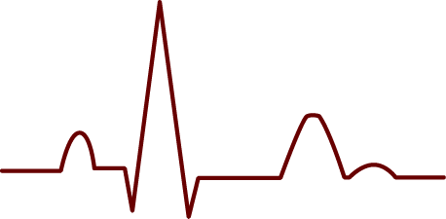
Early Heart Attack Detection Using Real Time ECG Signal
Presented By:Pooja Ingle
Guided By:Prof.S.D.Kale

Slide 2
Content
Motivation
Introduction
Literature Survey
Objective
Problem Statement
Dataset Selection
Proposed Solution
Output
Conclusion

Slide 3
Motivation
Heart attack detection delay: Heart attacks often strike suddenly, and symptoms can be misinterpreted or unnoticed until it's too late, highlighting the need for early detection.
Continuous heart monitoring with wearables: Smartwatches and other wearables now allow ECG signal capture, creating opportunities for real-time heart health monitoring.
Challenge of real-time data interpretation: The difficulty lies in accurately and quickly analyzing the vast amounts of ECG data to detect early warning signs.
CNNs for pattern recognition: Convolutional Neural Networks (CNNs) are powerful tools capable of identifying complex patterns, making them suitable for detecting early signs of heart attacks in ECG signals.

Slide 4
Introduction
Heart Attack as a leading cause of death: Early detection of heart attacks is crucial to saving lives.
Role of ECG signals: Electrocardiogram (ECG) signals capture the electrical activity of the heart. Subtle changes in these signals can indicate the early onset of a heart attack.
Wearable technology for real-time monitoring: Devices like smartwatches can now record real-time ECG data, offering a continuous stream of information for analysis.
Challenges in real-time ECG analysis: Analyzing ECG data in real time requires fast, accurate algorithms that can detect critical changes.
Convolutional Neural Networks (CNNs) for ECG analysis: CNNs are deep learning models capable of detecting patterns in complex data, making them suitable for recognizing signs of early heart attacks from ECG signals.
Benefits of combining technology and healthcare: By integrating CNNs with wearable devices, we can build systems that provide quick, reliable early warnings, improving response times and patient outcomes.

Slide 5
Literature Survey
Sr.no | Title of the Paper | Objective | Highlights
1. | ECG Based Early Heart Attack Prediction Using Neural Networks(2022) | To predict early heart attacks using neural networks and evaluate the accuracy of different deep learning techniques. | Dataset: UCI ML Dataset Method-Naive Bayes, SVM, k-NN, CNN, ANN
2. | Real-Time Multilead Convolutional Neural Network for Myocardial Infarction Detection(2018) | To detect myocardial infarction using multilead ECG with a CNN-based algorithm. | Dataset:PTB diagnostic database Method:Beat segmentation, fuzzy information granulation, multilead-CNN with sub 2-D convolution and lead asymmetric pooling (LAP), real-time testing on MATLAB and ARM Cortex-A9.
3. | ECG Signal Classification Using Deep Learning Techniques Based on the PTB-XL Dataset(2021) | To automatically classify ECG signals using deep learning techniques for cardiovascular disease diagnosis. | Dataset:PTB-XL database Method: convolutional network, SincNet, and a convolutional network with entropy-based features.

Slide 6
Objectives
1.The goal is to use a smartwatch to monitor heart activity and catch early signs of a heart attack, so people can get help sooner and stay healthier.
2.To make heart health monitoring simple and convenient, so anyone can keep an eye on their heart and take action if something's wrong.
3. To alert people quickly if their heart shows signs of trouble, helping them get medical help before things get serious.

Slide 7
Problem Statement
Developing a reliable, user-friendly system for early heart attack detection using ECG sensors on smartwatches is essential. The project aims to address key challenges, including ensuring accuracy and reliability of readings, developing advanced data analysis algorithms, implementing timely alerts, protecting privacy.

Slide 8
Dataset Selection
Dataset Link:
https://www.kaggle.com/datasets/drkhaledmohsin/national-heart-foundation-2023-ecg-dataset?select=ECG+Data
Description:
Categories:
Abnormal Heartbeat Patients:These abnormalities may include atrial fibrillation, bradycardia, tachycardia, ectopic beats, or other arrhythmias. Analysis of these images aids in diagnosing and managing various cardiac conditions.
Myocardial Infarction Patients:These images typically show characteristic changes in the ECG waveform, such as ST-segment elevation or depression, T-wave inversion, or pathological Q-waves, indicative of myocardial damage.
Normal Persons:Images in this group represent ECG readings from individuals with no apparent cardiac abnormalities. The ECG traces from these individuals serve as reference or baseline patterns for comparison with abnormal readings, facilitating the identification of deviations from normal cardiac activity.

Slide 9
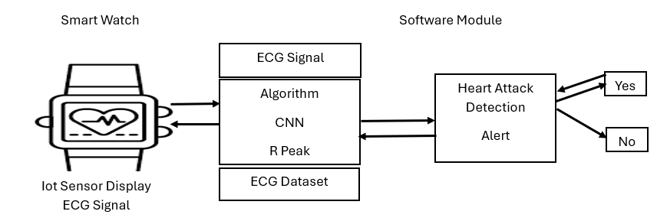
Proposed Solution
Figure 1: Framework of Early Heart Attack Detection using ECG and CNN on Smartwatch
Figure 1 Shows the following:
1. Smartwatch with ECG Sensor
2. Data Transmission
3. CNN Model for ECG Analysis
4. Detection of Irregularities
5. User Alert System

Slide 10
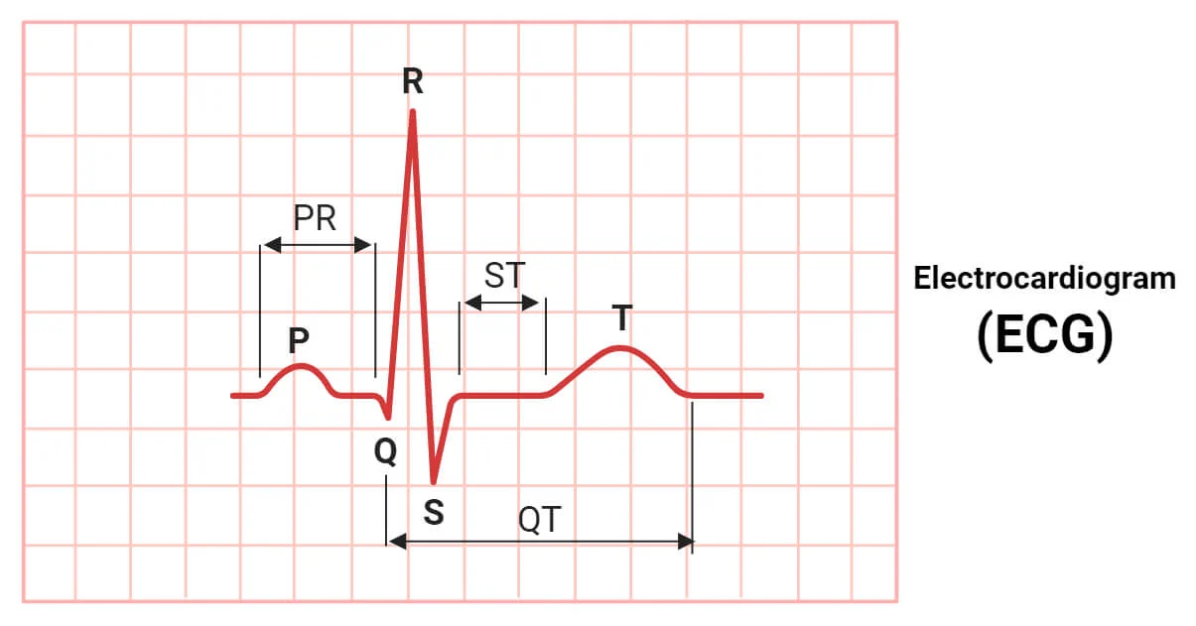
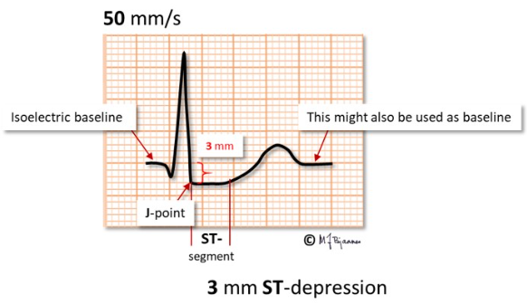
The Key to Identifying a Heart Attack on ECG
ST Depression
Significance: It can still indicate a heart attack, but it might suggest partial blockage of a coronary artery, requiring careful management but not the same level of emergency as STEMI.
3 mm ST depression is considered a marked depression, often signaling myocardial ischemia—a condition where the heart muscle isn't receiving enough oxygen due to reduced blood flow, usually because of narrowed or blocked coronary arteries.

Slide 11
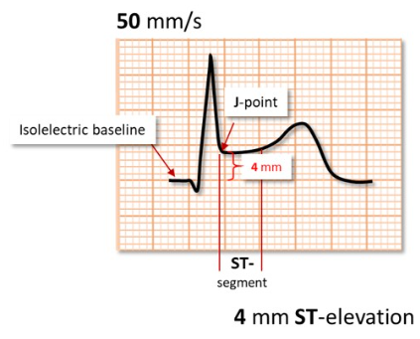
Significance:
ST-Elevation Myocardial Infarction (STEMI), which indicates a complete blockage of a coronary artery.
It is an emergency condition and requires immediate medical attention, usually with interventions such as thrombolysis or angioplasty.
4 mm ST elevation is considered a severe elevation, typically suggesting a more serious form of heart injury.
2.ST Elevation Myocardial Infarction

Slide 12
R-Peak Detection
R-peak detection is used to identify the position of the R-wave in the ECG signal, which marks the point of maximum ventricular depolarization. This is important for accurately locating and analyzing the ST segment, which follows the S-wave and represents the period of ventricular depolarization recovery.
R-peak detection helps in locating the ST segment (usually 60-80 ms after the R-peak).
The ST segment is then analyzed for elevation or depression, which can indicate conditions like heart attack or ischemia.
Thus, R-peak detection provides a reference point for ST segment analysis, aiding in the detection of heart conditions.

Slide 13
Steps for R-Peak Detection
Preprocessing the ECG Signal:
Remove baseline wander and noise using high-pass filtering and/or a bandpass filter (e.g., 0.5–40 Hz).
Detect the QRS Complex:
Use a differentiation-based method like Pan-Tompkins or wavelet transforms to detect QRS complexes.
Identify high slopes and prominent amplitudes in the ECG signal.
Locate the R-Peak:
Within the detected QRS complex, find the local maximum which corresponds to the R-wave.
The R-peak is typically located before the ST segment starts.
Identify the ST Segment:
The ST segment begins at the J-point, which is the end of the S-wave (downward deflection).
The ST segment is relatively flat in a normal ECG and starts after the R-peak.
Confirm R-Peak Using the ST Segment:
If the ST segment has been identified, ensure that the R-peak precedes the start of the ST segment.
This helps reject false R-peak detections.

Slide 14
Calculation
Steps:
1.Calculate baseline:
Baseline interval:1000-(0.04*500) to 1000-(0.01*500)
interval=980 to 995
Mean baseline value=0.1
2.Calculate ST Level:
ST interval:1000 + (0.06*500) to 1000 +(0.08*500)
Interval=1030 to 1040
Mean ST level =Mean([0.2,0.21,0.22])=0.21
3.ST Elevation = 0.21-0.1=0.11
following values:
Sampling rate = 500 Hz
R-peak index = 1000
Signal levels:
Baseline: 0.1
ST segment values: [0.2,0.21,0.22]

Slide 15
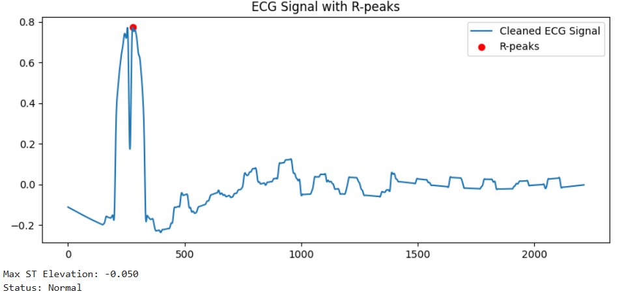
Output:

Slide 16
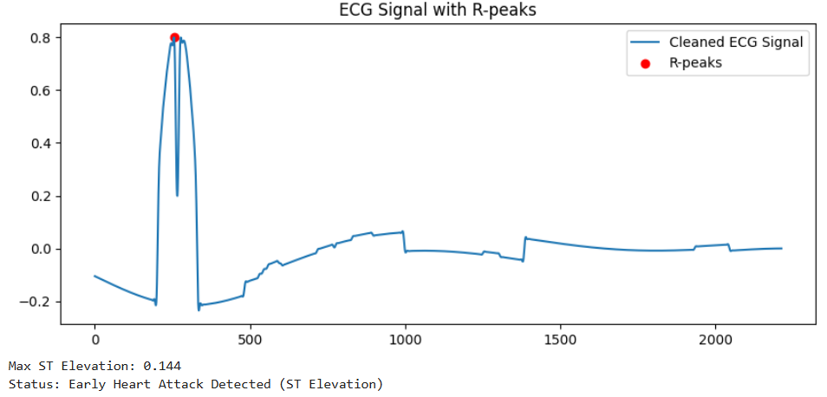

Slide 17
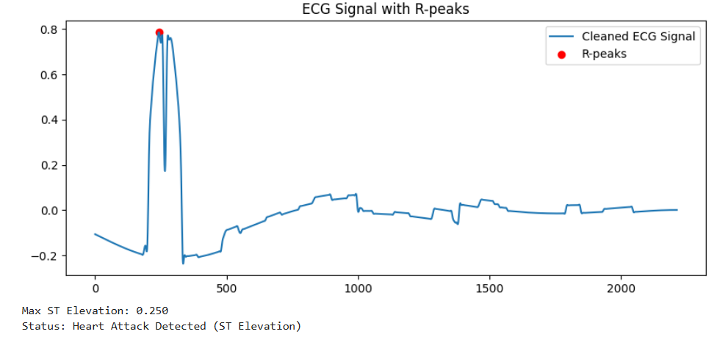

Slide 18
Conclusion
The ECG signal from an image, processes it to detect R-peaks, and analyzes the ST-segment for signs of a heart attack.
The ST-segment following each R-peak is analyzed for elevation or depression to classify the ECG as normal, early heart attack, or heart attack detected.
Results are visualized, and the classification outcome is displayed, providing a comprehensive pipeline for heart attack detection from ECG images.

Slide 19
Thank You……

